Slide 1

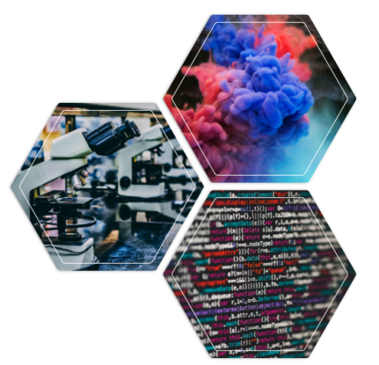
Introduction to Databases and Ontologies
Sadia Madhuri Rasha
B160305043
26/05/23 Computer Science and Engineering Department, Jagannath University 1

Slide 2
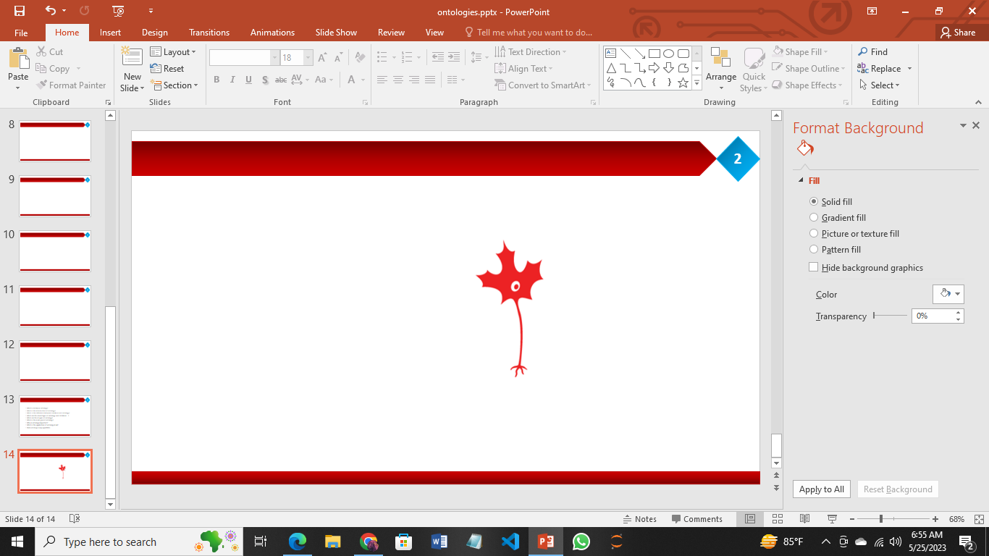
Outline
2
Introduction
NIF - the Neuroscience Information Framework
Federating neuroscience-relevant databases
Structured information: data, databases
Information frameworks
Ontologies
Databases
Conclusions

Slide 3
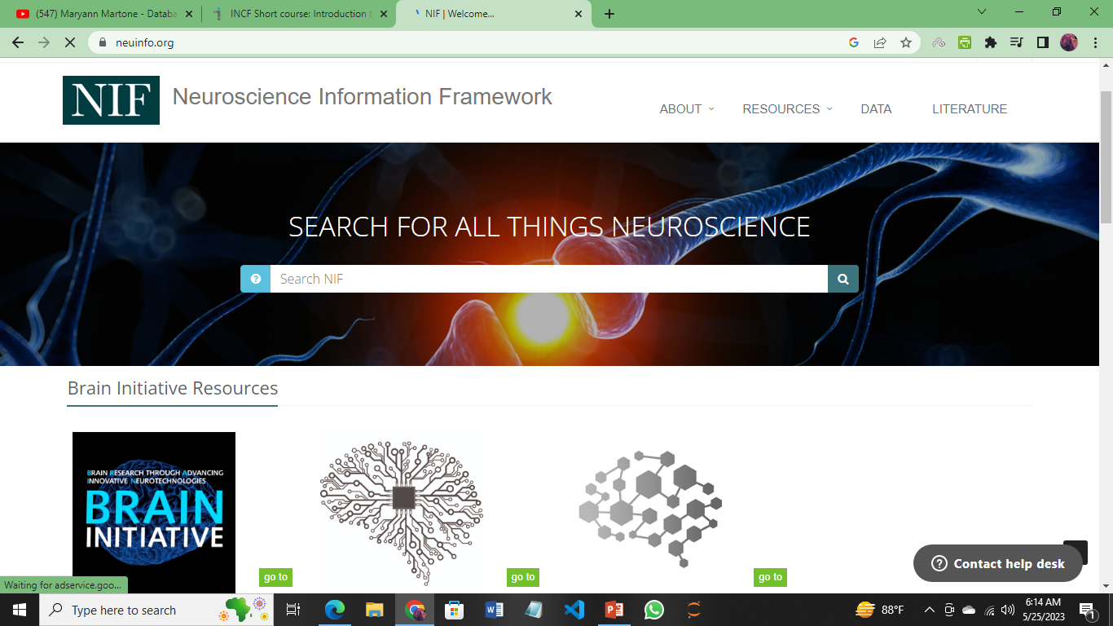
NIF - Neuroscience Information Framework
3
2000 databases
170 federating databases
https://neuinfo.org/

Slide 4
NIF - Neuroscience Information Framework
4
The Neuroscience Information Framework is a dynamic repository of Web-based neuroscience, global neuroscience web resources, including experimental, clinical, and translational neuroscience databases, knowledge bases, atlases, and genetic/genomic resources and provides many authoritative links throughout the neuroscience portal of Wikipedia.
Data format: html, xml, json, csv
Established in 2004 by the National Institutes of Health.
Development of the NIF started in 2008, when the University of California, San Diego School of Medicine obtained an NIH contract to create and maintain "a dynamic inventory of web-based neurosciences data, resources, and tools that scientists and students can access via any computer connected to the Internet.
https://en.wikipedia.org/wiki/Neuroscience_Information_Framework

Slide 5
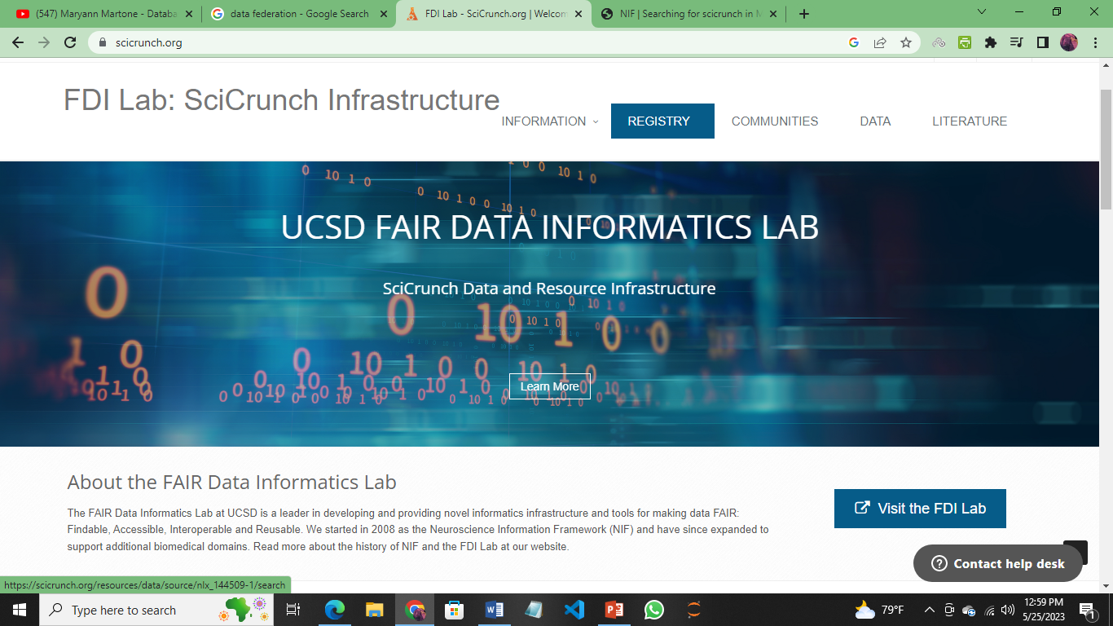
NIF- SciCrunch
5
The main goal of establishing NIF is to build a culture of data sharing.
This creates a strong community of researchers as “One mind for research”.
SciCrunch- NIF has been adapted to create SciCrunch to create more narrow community based portals based on common data platform.
Cost effective. Data portal can be
set up in a few hours.
Allows researchers organize and
store their data.
Connects communities through
data and tools.
Shared curation shared knowledge
https://scicrunch.org/

Slide 6
Data Federation
6
Data Federation: is a software process that allows multiple databases to appear and function as one. This creates virtual database that takes data from a range of sources and converts them all to a common model.
This provides a single source of data for front-end applications. A data federation is part of the data virtualization framework.
Data virtualization grew with data federation but sprouted extra features, applications, and functions
Examples: Teradata with Query Grid, IBM Pure Data Systems with Fluid Query, and SAP HANA with Smart Data Services are some of the products offering data federation.
https://www.tibco.com/reference-center/what-is-a-data-federation

Slide 7
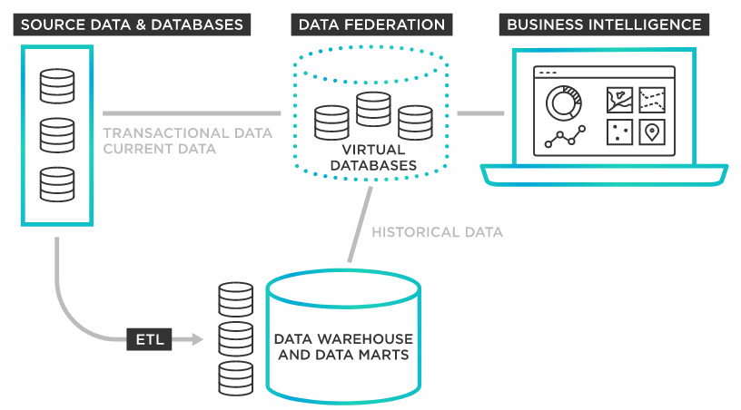
Data Federation
7

Slide 8
Why data federation?
8
Data federation eliminates the need to create yet another database or data warehouse and save the cost of creating a permanent, physical relational database.
It manages the integration of individual databases from different sources with a central data store and makes it accessible under a uniform data model through virtualization rather than by physical storage.
It enables querying data from different sources into a single virtual format. As such, data federation has fewer points of potential failure and provides better data integration.
A key advantage of the federation approach is that it allows for real-time information access

Slide 9
Federated Database
9
Federated Database: system is a type of meta-database management system, which transparently maps multiple autonomous database systems into a single federated database. The constituent databases are fully integrated and interconnected via a computer network and can be geographically decentralized.
Data sources could be both structured (relational databases, XML documents, etc) and/or unstructured (Excel spread sheets, medical records, etc).
Because various database management systems employ different query languages, federated database systems can apply ‘wrappers’ to the subqueries to translate them into the appropriate query language.
https://en.wikipedia.org/wiki/Federated_database_system

Slide 10
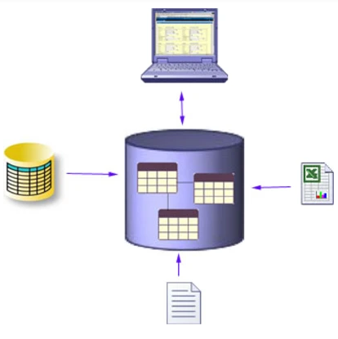
Data Federation VS Data Warehouse
10
Data Federation VS Data Warehouse:
Data federation software creates a single repository that doesn’t contain the data itself, rather its metadata (information about the actual data/its location). It involves transformation, cleansing, and possibly even enrichment of data in a decentralized manner while data warehouse or enterprise data warehouse (EDW) is a major alternative to a data federation. It creates a centralized repository that pulls data from multiple sources for analysis and integrates data physically.
DF does not need to move or copy data and it prevents data from being changed. While an EDW moves data into a single repository and updates data.

Slide 11
Structured vs Unstructured Data
11
Two main categories of data is: structured and unstructured data type.
Structured data is highly specific and is stored in a predefined format, where unstructured data is a compilation of many varied types of data that are stored in their native formats. This means that structured data takes advantage of schema-on-write and unstructured data employs schema-on-read.
Structured data consists of clearly defined standardized data types with patterns that make them easily searchable while Unstructured data is more difficult to collect, process, and analyze.
Common examples of structured data include customer relationship management (CRM), invoicing systems, product databases, and contact lists. Unstructured data includes various content such as documents, videos, audio files, posts on social media, and emails.

Slide 12
Requirements for Effective Data Sharing
12
Discoverability
Data can be found
Accessibility
Data can be accessed
Assessability
The reliability of the data can be determined
Understandability
Data can be understood
Usability
Data are in a usable form
Population
Comprehensive coverage of domain
Up to date information
Trusted source
Provenance of data
Quality of curation

Slide 13
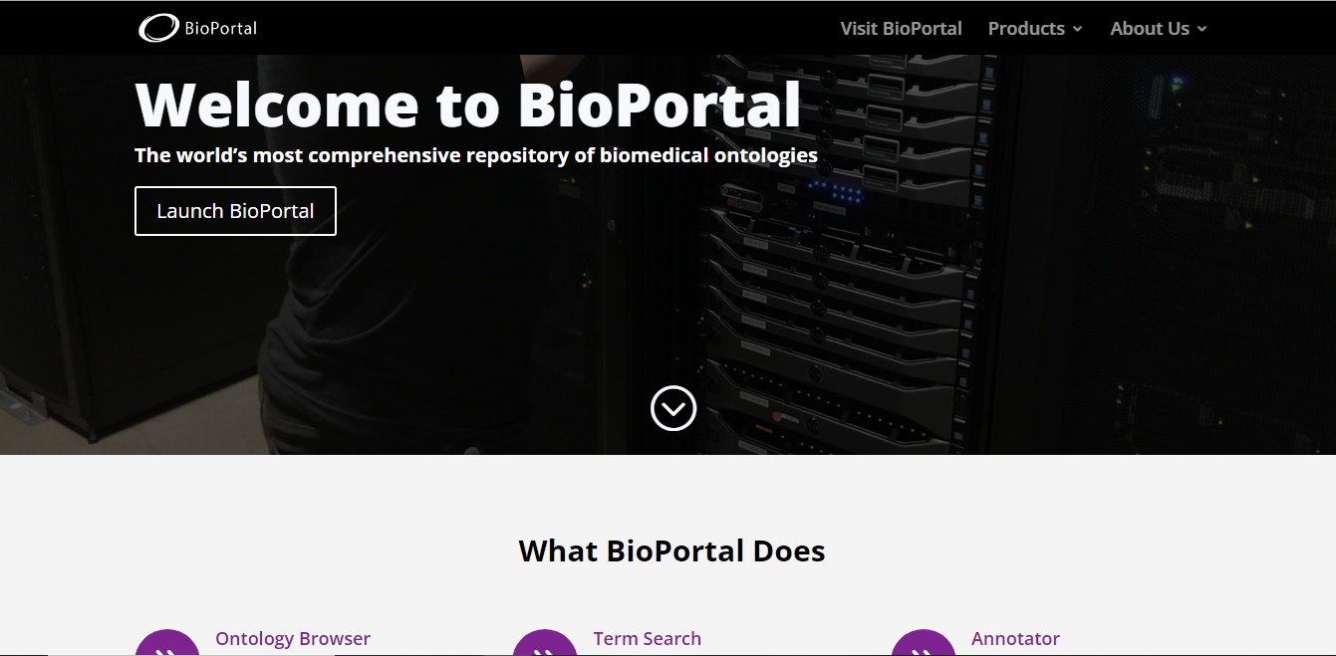
Introduction to Ontologies
13
Ontology comes from two Greek words: on, which means "being," and logia, which means "study." So ontology is the study of being alive and existing. The term is generally credited to the great Ionian mathematician, scientist, and religious mystic Pythagoras
https://www.bioontology.org/

Slide 14
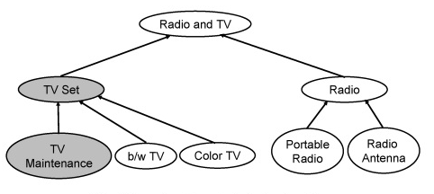
Ontology
14
Ontology: An ontology is a formal representation of knowledge that consists of a set of classes that represent concepts defining a field and the relationships among these classes.
In simple terms, ontology is a data structure that specifies, for a given application area,
Entities
Properties of entities
Relationships among the entities

Slide 15
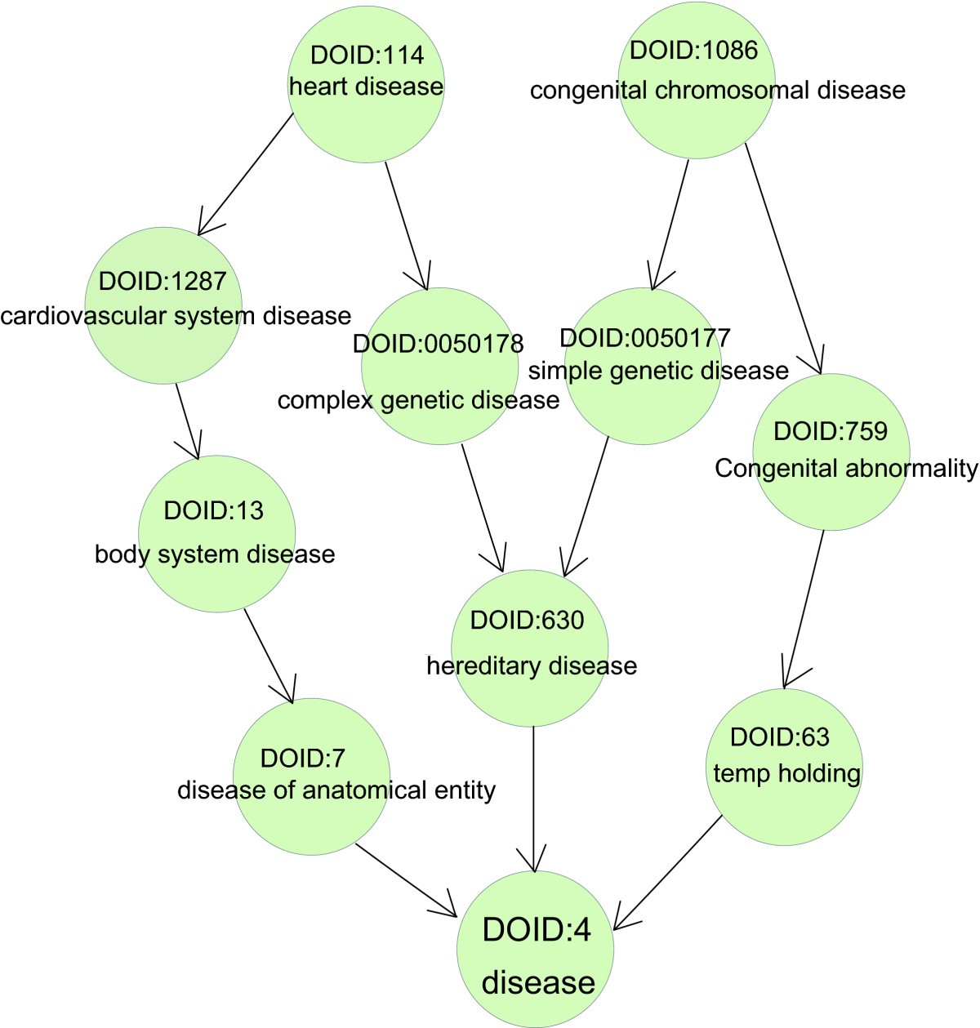
NIF Semantic Frame Work - NIFSTD
15
NIF Standard Ontology (NIFSTD): is a core component of Neuroscience Information Framework (NIF) project (http://neuinfo.org), a semantically enhanced portal for accessing and integrating neuroscience data, tools and information.
NIFSTD includes a set of modular ontologies that provide a comprehensive collection of terminologies to describe neuroscience data and resources.
Fig: Ontology of diseases:

Slide 16
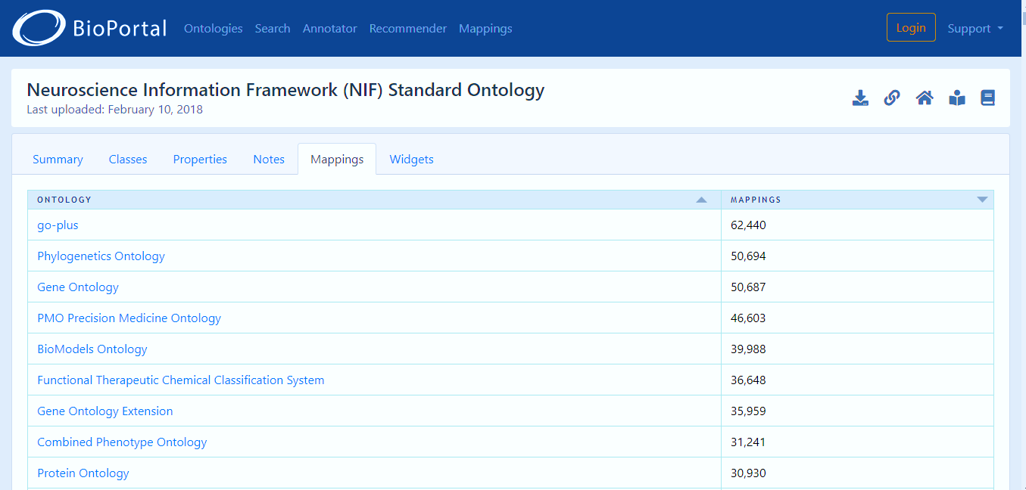
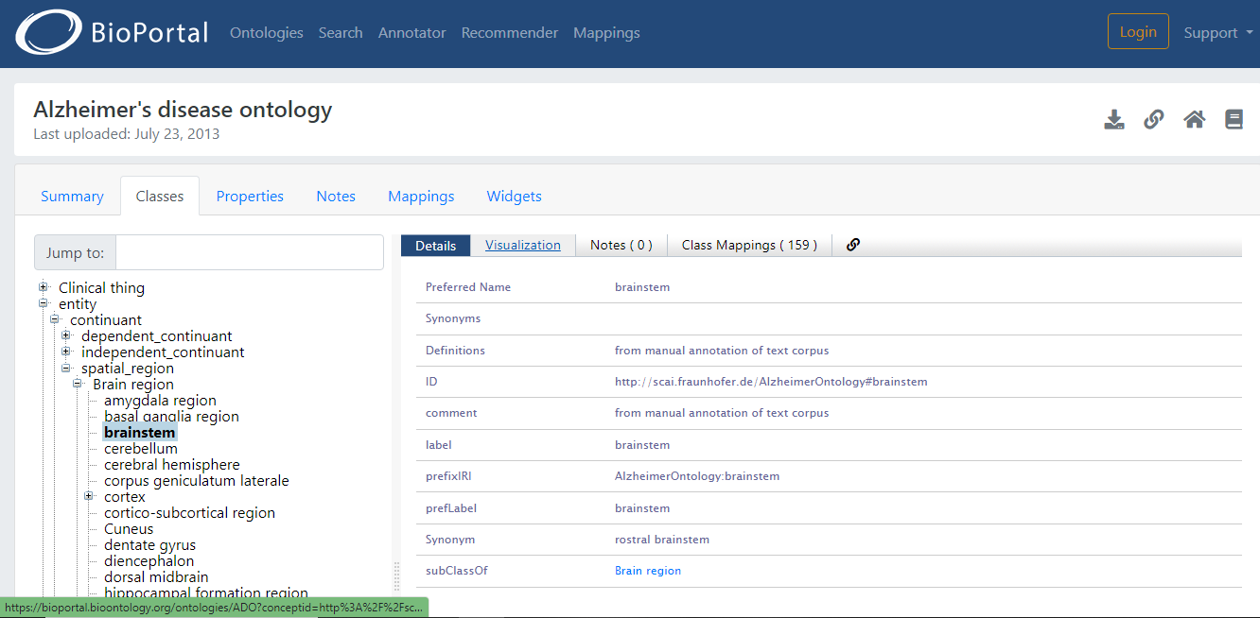
Ontology (Cont.)
16
Typically ontology can be seen as a 5-tuple where its components are: Concepts, relationships, functions, instances and axioms.

Slide 17
Why develop an ontology?
18
It shares a common understanding of information under a particular domain that allows:
organizations to make better sense of their data.
Provide explicit meaning of the entities among peoples and software.
It defines and arranges the classes in the ontology in a taxonomic (subclass–superclass) hierarchy, then define the roles and values for these classes.
Increased quality of entity analysis. Increased use, reuse, and maintainability of the information systems.
Explains the properties of each classes describing features and attributes of the class.
Facilitation of domain knowledge sharing, with common vocabulary across independent software applications.

Slide 18
How to develop an ontology?
19
Step 1: Determine the domain and scope of the ontology. The ontology have to contain enough information to answer the following list of questions:
What is the domain that the ontology will cover?
For what we are going to use the ontology?
For what types of questions the information in the ontology should provide answers?
Who will use and maintain the ontology?
https://protege.stanford.edu/publications/ontology_development/ontology101.pdf

Slide 19
How to develop an ontology?
20
Step 2: Consider reusing existing ontologies.
Refine and extend existing sources for the particular domain and task.
May be a requirement if our system needs to interact with other applications that have already committed to particular ontologies or controlled vocabularies.
Step 3: Enumerate important terms in the ontology.
List all terms needed to make statements to explain to a user.
List all the properties belongs to that terms have.
Example:
– Important wine-related terms will include wine, grape, winery, location, a wine’s color, body, flavor and sugar content;
– Subtypes of wine such as white wine, and so on.
https://protege.stanford.edu/publications/ontology_development/ontology101.pdf

Slide 20
How to develop an ontology?
21
Step 4: Define the classes and the class hierarchy.
Start by defining classes from the list created in Step 3.
Classes in the ontology: – The terms that describe objects having independent existence rather than terms that describe these objects.
Organize the classes into a hierarchical taxonomy by asking if by being an instance of one class.
If a class A is a superclass of class B, then every instance of B is also an instance of A
Possible approaches of creating class hierarchy :
A top-down development process starts with the definition of the most general concepts in the domain.
A bottom-up development process starts with the definition of the most specific classes.
A combination development process is a combination of the top-down and bottom-up approaches
https://protege.stanford.edu/publications/ontology_development/ontology101.pdf

Slide 21
How to develop an ontology?
22
Step 5: Define the properties of classes (slots).
Remaining terms created in step 3 are properties of these classes.
From the wine example, the remaining terms are: wine’s color, body, flavor, sugar content and location of a winery.
For each property in the list, determine which class it describes.
In the example: the Wine class will have the following slots:
color, body, flavor, and sugar.
All subclasses of a class inherit the slot of that class.
https://protege.stanford.edu/publications/ontology_development/ontology101.pdf

Slide 22
How to develop an ontology?
23
Step 6: Define the facets of the slots.
Slot can have different facets describing the value type, allowed values, the number of the values (cardinality), and other features of the values the slot can take.
E.g. The value of a name is a string.
Slot cardinality – defines how many values a slot can have. Some systems distinguish only between single cardinality and multiple cardinality.
Slot-value type – A value-type facet describes what types of values can fill in the slot.
https://protege.stanford.edu/publications/ontology_development/ontology101.pdf

Slide 23
How to develop an ontology?
24
Step 7: Instances of classes in the hierarchy.
Defining an individual instance of a class requires
choosing a class
creating an individual instance of that class
filling in the slot values.
https://protege.stanford.edu/publications/ontology_development/ontology101.pdf

Slide 24
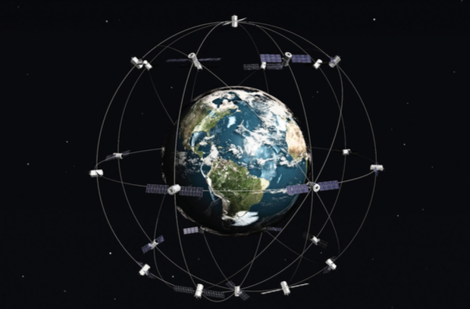
Applications of Ontologies
25
Machine Learning & Deep Learning: Supervised and unsupervised machine learning algorithms applied to well known, and understood data can rapidly detect failures and put corrective actions into motion before severe damage occurs.
Business Intelligence (BI): Any enterprise information architecture intended to enable horizontal communication between disparate data sources, with related and/or potentially different domains (e.g., banking and insurance), must identify an ontology for rapidly merging, and extracting Key Data Elements (KDE) necessary for answering essential competency questions.

Slide 25
Applications of Ontologies
26
Ontology in AI: The ontology sets the scene for the knowledge graph to capture the data in a domain by specifying the structure of the knowledge in that domain including taxonomies, topic maps, logical models, and vocabularies.
Personalized Shopping
AI-Powered Assistants
Fraud Prevention
Administrative Tasks Automated to Aid Educators
Creating Smart Content
Voice Assistants
Personalized Learning
Autonomous Vehicles.
Natural Language processing
Cognitive AI
Ontology in research: Ontology helps researchers recognize how certain they can be about the nature and existence of objects they are researching.

Slide 26
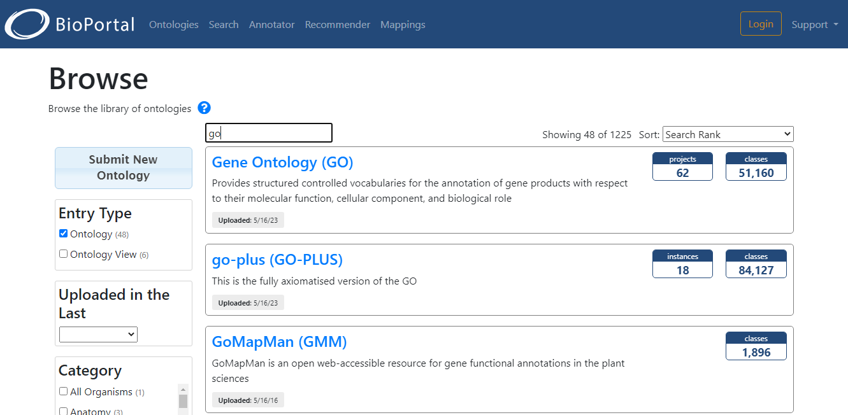
Applications of Ontologies
27
Ontology in Biomedicine: Ontologies are used in the biomedical and health sciences in areas ranging from gene function, as seen in the gene ontology GO, to those used in healthcare informatics such as the International Classification of Diseases, ICD.

Slide 27
Applications of Ontologies
30
Ontology in education: The ontology can be used to guide students to understand the organization of their own learning and to self- assess their own progress.
Ontology in neuroscience: Ontology is broadly used in Neuroscience Information Framework (NIF) project. NIFSTD and Web Ontology Language (OWL) are two important tools to analyze neuroscience data.

Slide 28
Databases vs Ontologies
28
The fundamental focus of an ontology is to specify and share meaning. The fundamental focus for a database schema is to describe data and storage.
A relational database schema has a single purpose: to structure a set of instances for efficient storage and querying. An ontology can also be used to structure a set of instances in a database but it has a broader range of purposes including better communication, interoperability, search, and software engineering, a communication bridge between a human and a machine.
When an instance is created in an ontology, the respective mappings must also be created based on rules, which is not necessarily the case for databases. That’s why ontology perform better than databases.
Ontologies utilize the OWA system of knowledge representation, while the CWA is used by databases.

Slide 29
Databases vs Ontologies
29
Database system apply the normalization of tables to delete redundant data from the tables, to reduce the complexity. Normal forms are a set of rules that help to correct the transformation of entities and relationships to the structure of the physical layout of the tables that is not used in ontologies.
A database uses an ER diagram to describe the syntax; this technique is used for abstract and conceptual data representation. In ontology, however, the syntax is written by logic; the most common is the description logic that corresponds to the OWL DL, a language for creating ontologies.
Ontologies can be created using existing ontologies while databases are created from scratch like all tables and their content have to design new.
But there are certain similarities between ontologies and databases. we can convert a database to an ontology and vice versa using the approach Ontology Inverse Engineering.

Slide 30
Purposes of Development of the Databases
30
Data dependency
Efficient data access;
Data integrity and security;
Data administration;
Concurrent access and crash recovery;
Reduced application development time.

Slide 31
Conclusions
31
What is NIF and it’s purposes?
What is data federation?
Data federation vs data warehouse
What is the introduction of ontology?
What is the difference between database and ontology?
What are the advantages of ontology over database?
What is the main goal of ontology?
Why is ontology important?
What is the application of ontology?
Web ontology Language(OWL)

Slide 32
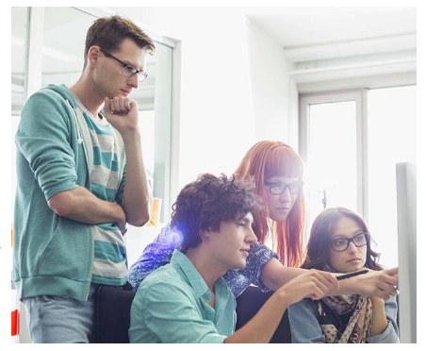
32
Thank You

